Slide 1
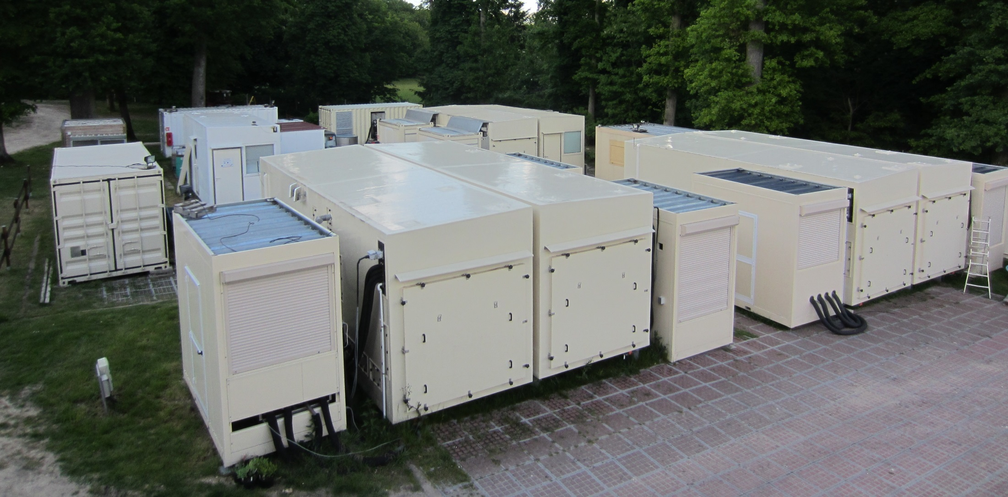
Ecotron-B2 experiments

Slide 2
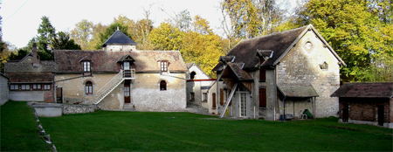
Ecotron Ile-de-France
Part of the Ecotron network (other location at Montpellier)
Centre for Research in Experimental and Predictive Ecology (CEREEP) & Ecotron Ile-de-France
Located at the site of Foljuif the Ecole Normale Supérieure (ENS) (Seine-et-Marne)
a Joint Service Unit (MSU) since January 1, 2008 between
  CNRS (French Centre National de la Recherche Scientifique)
  ENS

Slide 3
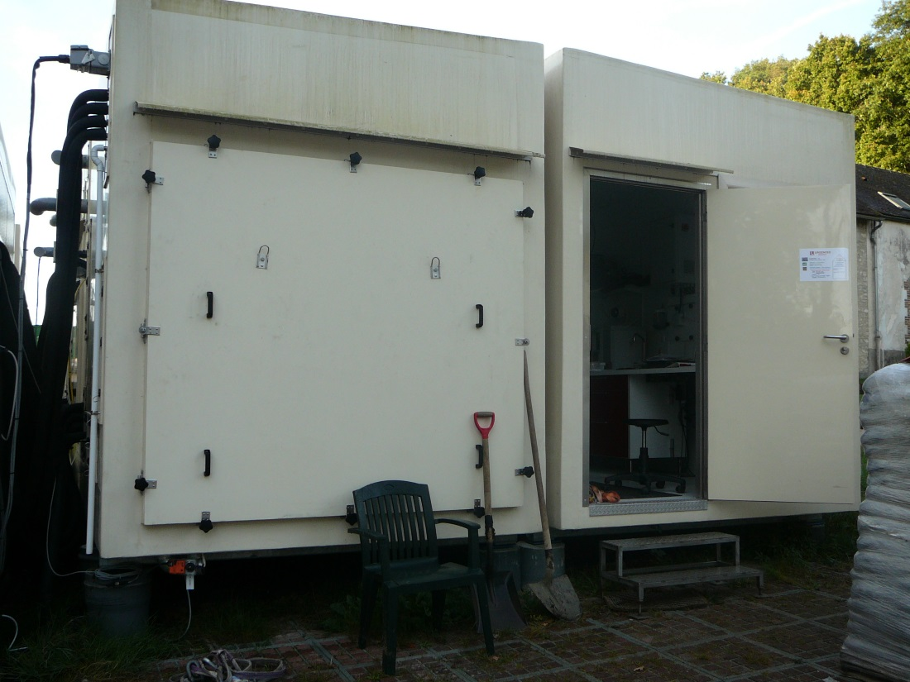
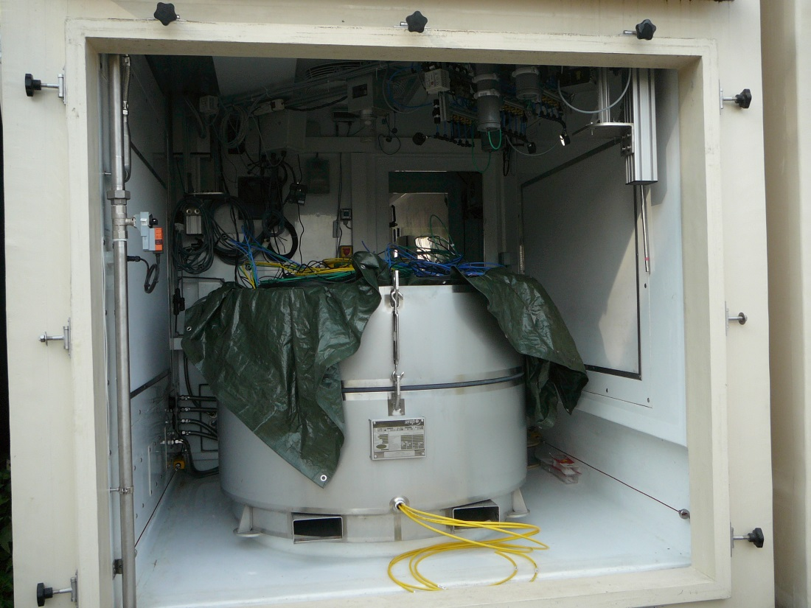
Ecolabs
Several Ecolabs
Each equipped with a control room and three controlled-environment cells
Total 10 cells available

Slide 4
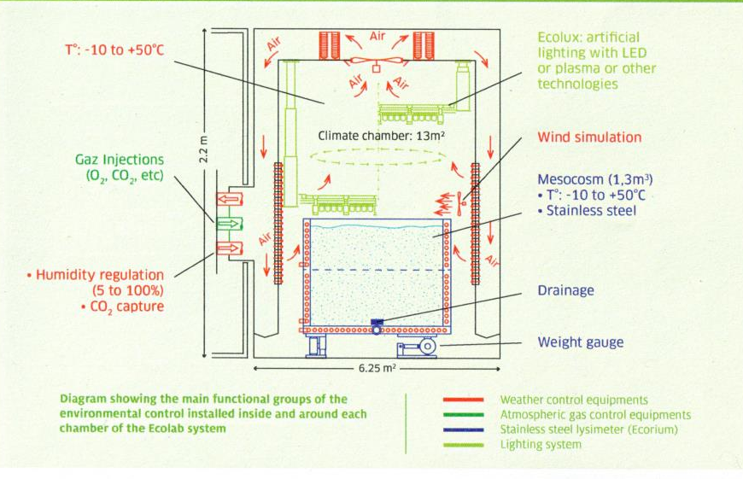
Ecolab cell design

Slide 5
Why Ecotron?
Gives ability to look at hydrobiogeochemical processes under conditions of high and independent control
  realistic temperature fluctuations
  water applications
  controlled atmospheric gas composition
Ecotron and LEO facilities offer complementary strength
Unique opportunity for LEO to test and build up to LEO-scale experiments using highly controlled experiments at Ecotron

Slide 6
Projects
Abiotic and biologically-driven basalt weathering and C sequestration under changing climate
Quantifying the importance of biotic and abiotic drivers in creating lags in soil carbon and water dynamics
Linking controls on microbial community composition with soil carbon dynamics

Slide 7
Abiotic and biologically-driven basalt weathering and C sequestration under changing climate
Goal is to quantify the abiotic and biological contributions to weathering and CO₂ flux during early colonization of the landscape by biota
Determine effect of
  Plant
  Atmospheric CO₂ concentration
  Temperature
  N-availability

Slide 8
Design
4 biological treatments
  Control
  Mesquite (30 mesquites per mesocosm) inoculated with Rhizobia
  Bunchgrass (green sprangletop, Leptochloa dubia)
  Legume grass (alfalfa, Medicago sativa) inoculated with Rhizobia
2 temperature treatments
  Ambient (21-26 deg C air, 23.5 deg C bottom of Ecorium
  Elevated 4 degrees (25-30 deg C air, 27.5 deg C bottom of Ecorium )
2 CO₂ treatments
  400 ppm
  800 ppm
4 replicates – 2 in space and 2 in time
64 mesocosms (40 cm d by 80 cm depth) total

Slide 9
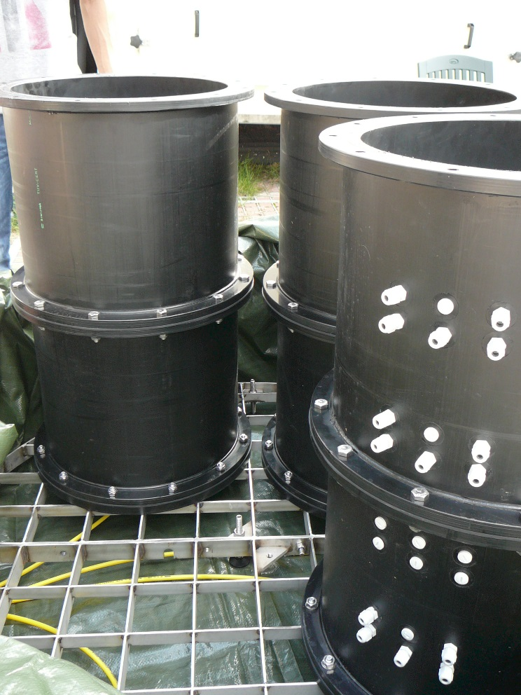
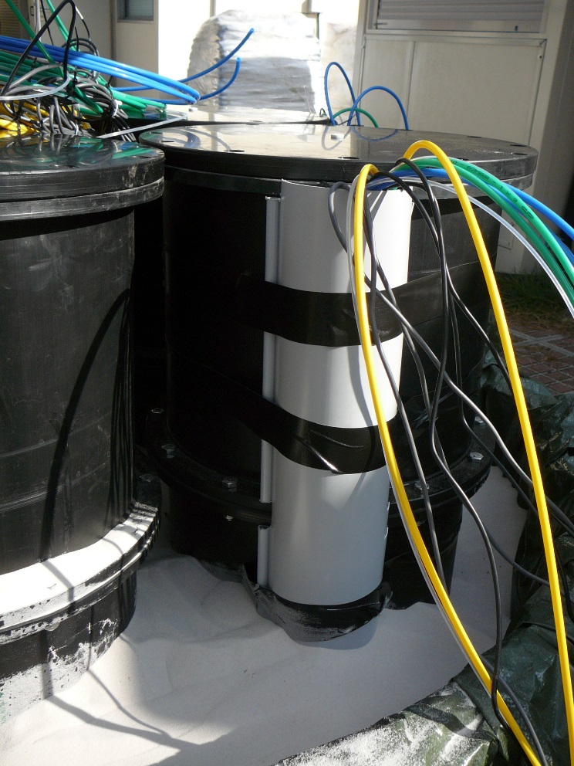
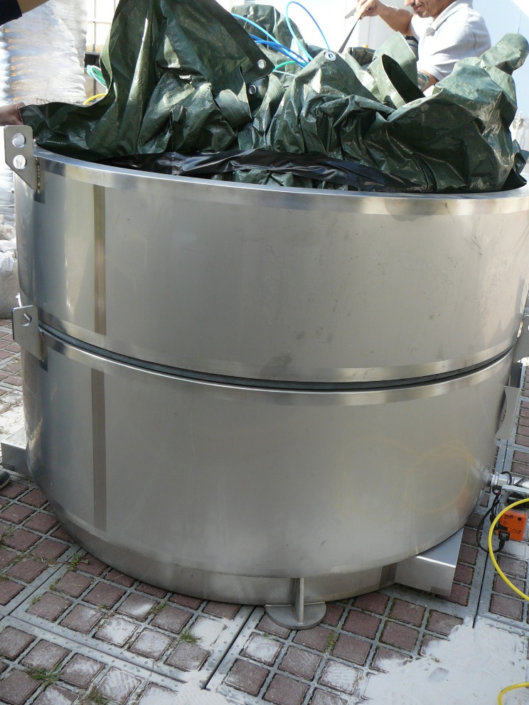
Design
Ecorium installation
  4 mesocosms per Ecorium
  Mesocosm bottom plates have 2% slope
  Ecociums are filled with sand for heat transmission

Slide 10
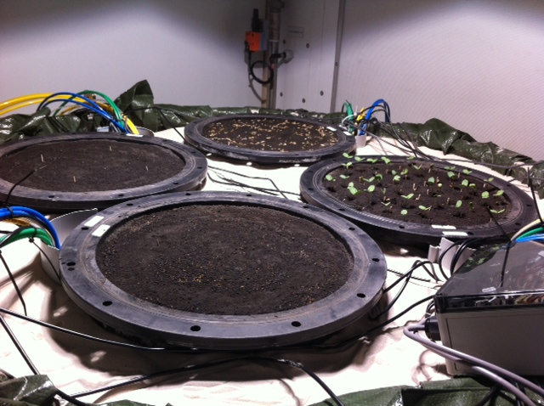
Design

Slide 11
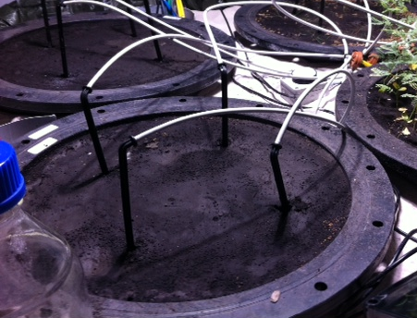
Design
Rainfall
  4 large rainfall events over 4 month (37.5 mm/h *2.5h = 93.75 mm or 11L) with small events to support plant growth (5mm /h *2 h = 10 mm) in-between
  Delivered through 4 drippers/mesocosm
  Total 555 mm over 4 month
  Water pre-equilibrated with CO₂ in cell atmosphere

Slide 12
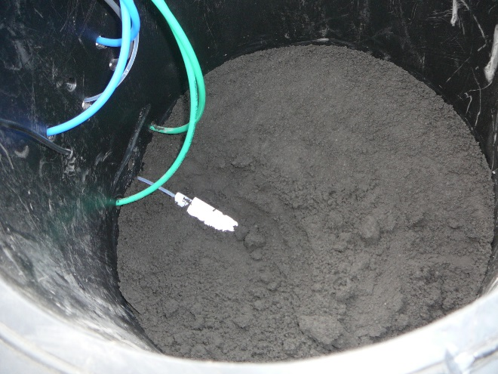
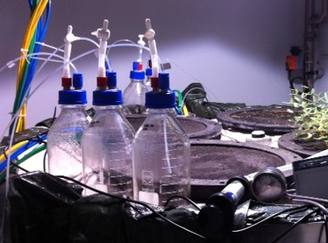
Design
Solution sampling and analysis
  3 depth + drainage
  Sampled once per rainfall
  Rainfall staggered over the week 2 cells at a time
  Next week is devoted to sample processing at Ecotron and analysis at the Institut de Physique du Globe de Paris (IPGP)
  pH, conductivity, O₂, alkalinity at Ecotron
  DIC, DOC, TN, metals by ICP-MS and ICP-OES, anions by IC at IPGP
Notes:
Paris Institute of Earth Physics

Slide 13
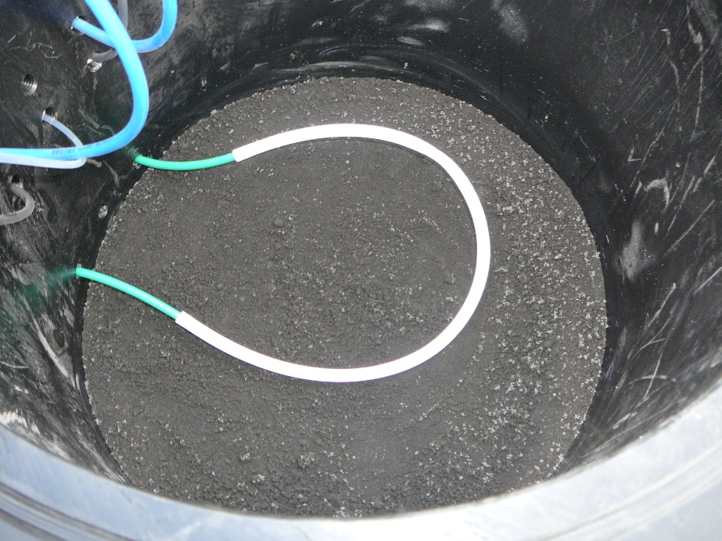
Design
Gas sampling
  Vaisala probes connected to sampling loops at 3 different depth, same as solution samplers

Slide 14
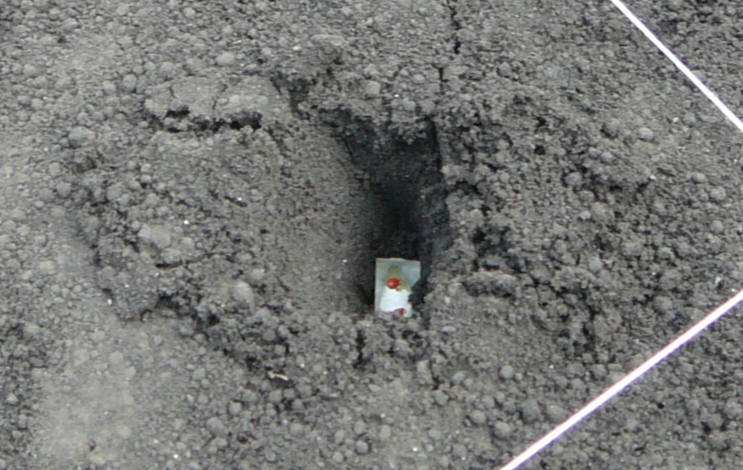
Design
Solid phase sampling and analysis
  Destructive sampling at the end of 4 month period
  TOC, TIC, TN
  SEM, XRD
  TEM, Scanning transmission X-ray microscopy (STXM), synchrotron XRD
  Crystal dissolution for direct weathering measurement
  Polished olivine, labradorite, glass crystals buried at 5 cm depth
Vertical scanning interferometer-measured surface dissolution of four different crystals. (Daval et al., 2013)
Notes:
Scanning transmission X-ray microscopy

Slide 15
Design
Microbial measurements
  Every month samples collected on soil surface (2 cm)
  Samples preserved for microbial biodiversity analyses at GenoSol Platform, Dijon
  Enzyme activities measurements performed at Biochem-Env platform, Versailles-Grignon
  Time zero completed – no detectable enzyme activity

Slide 17
Experiment 1
(4 month, repeated twice)
Ambient T
+4° C T
CO₂ = 800 ppm
CO₂ = 400 ppm
CO₂ = 800 ppm
CO₂ = 400 ppm
No plants
Mesquite
No plants
Mesquite
No plants
Mesquite
No plants
Mesquite
Legume grass
Bunch-grass
Legume grass
Bunch-grass
Legume grass
Bunch-grass
Legume grass
Bunch-grass
No plants
Mesquite
No plants
Mesquite
No plants
Mesquite
No plants
Mesquite
Legume grass
Bunch-grass
Legume grass
Bunch-grass
Legume grass
Bunch-grass
Legume grass
Bunch-grass

Slide 18
Experiment 2
(6 month)
Soil
Mesquite
Soil
Mesquite
Soil
Mesquite
Ambient T
Grass
Mesquite + Grass
Grass
Mesquite + Grass
Grass
Mesquite + Grass
Soil
Mesquite
Soil
Mesquite
Soil
Mesquite
+4° C T
Grass
Mesquite + Grass
Grass
Mesquite + Grass
Grass
Mesquite + Grass

