Slide 1
Guiding Principles for Climate Control at LEO
Would we like to manipulate the air circulation (e.g. velocity, direction) within LEO in ways that exceed our current controls?
Are there threshold air and soil temperatures we do not want to exceed?
What are the causes of spatial variability in air/soil temperature in LEO? Are those sources interesting, or artifacts of the laboratory environment? And can we control those sources to meet research objectives?

Slide 2
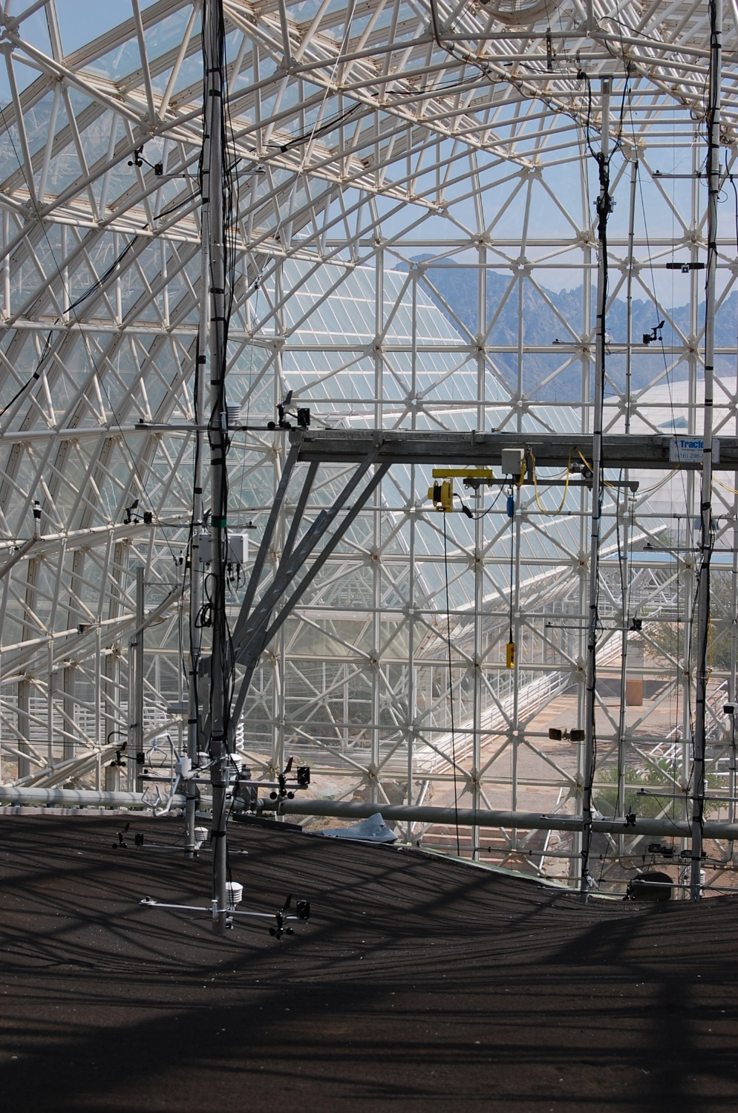

Slide 3
Wind profiles at five locations over LEO-E.
Air handler combination | Operation Times
L-9 | 13:10 – 14:00
L-8 | 14:00 – 15:00
L-4 | 15:00 – 16:00
L-9 and L-8 at 100%ª | 16:00 – 17:00
L-9 and L-4 at 100% | 17:00 – 18:00
L-8 and L-4 at 100% | 18:00 – 19:00
L-9, L-8, and L-4 at 100% | 19:00 – 20:00
ªThe percentage indicates the relative aperture of a diaphragm through which the air flows.

Slide 4
Wind profiles at five locations over LEO-E. In this case, the large fan installed in the air shaft at the north wall was also running.
Air handler combination | Operation Times
L-9 | 9:00 – 10:00
L-8 | 10:00 – 11:15
L-4 | 11:15 – 12:15
L-9 and L-8 at 100%ª | 12:15 – 13:30
L-9 and L-4 at 100% | 13:30 – 14:35
L-8 and L-4 at 100% | 14:35 – 15:30
L-9, L-8, and L-4 at 100% | 15:30 – 16:30
ªThe percentage indicates the relative aperture of a diaphragm through which the air flows.

Slide 5
Observations
Minimal air circulation above 1-m height unless at least two air handlers are running at 100%, along with the fan mounted in the air shaft along the north wall.
Maximum wind speeds approach 1 m/s.
There is some tendency for greater wind speeds at upslope and midslope positions, although different combinations of air handlers create much horizontal variability (as well as vertical).

Slide 6
Temperature profiles at five locations over LEO-E. The red line at 0.25-m height is erroneous data and can be ignored.

Slide 7
Observations
When there is no air circulation (i.e. on 3/23) there is horizontal variability in air temperature on the order of ~ 1-8°C – this can be seen at the 0.25, 1, and 3-m heights.
With air handlers and the additional fan operating, the horizontal variability at the same heights is reduced to 1-2°C.

