Slide 1
New opportunities for in situ sampling of water and carbon-dioxide isotopologues within the soil and atmosphere at LEO

Slide 2
Why measure soil water and CO₂ isotopes in LEO basalt (and atmosphere)?
Isotopic analyzer
Sampling set up for soil air CO₂ and vapor
Inference of liquid water isotopes
Atmospheric sampling
(Potential scheme for soil gas sampling)

Slide 3
Sampling H₂O isotopologues at LEO - What can we learn?
Pathways of water through the hillslope – time evolution, interaction with weathering
Subsurface mixing and transport at scale of soil profiles to hillslope
Transit times and age distribution of water
Evapotranspiration

Slide 4
Sampling CO₂ isotopologues at LEO - What can we learn?
Contribution of chemical and biological process to carbon dynamics
Limiting effect of CO₂ diffusion from atmosphere for carbon uptake within slope
Equilibrium of gas-phase CO₂ with the solution phase
Carbonate precipitation within the slope
Plant uptake of CO₂ from the atmosphere

Slide 5
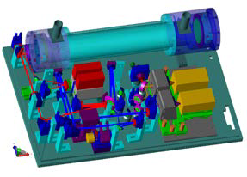
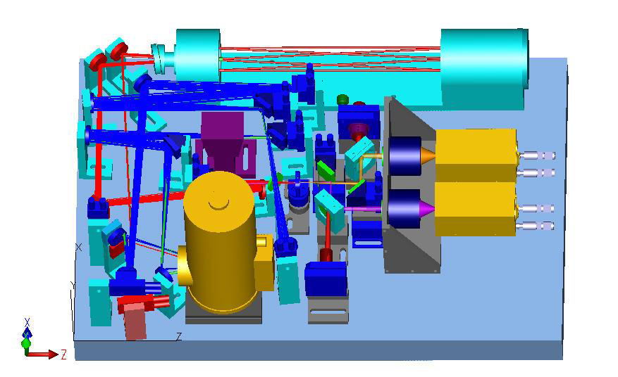
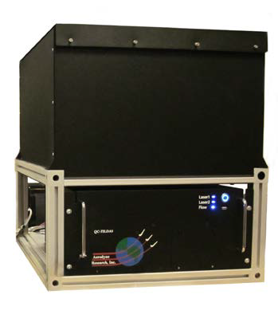
Aerodyne real-time dual continuous wave quantum cascade laser
Continous analyis of gas stream
Fast time response
Two characterized IR tunable lasers
  CO₂, ¹³CO₂, CO¹⁸O with one laser
    δ¹⁸O-CO₂ with σ(1 Hz) < 0.1 ‰
    δ¹³C-CO₂ with σ(1 Hz) < 0.1 ‰
  H₂O, HDO, H₂¹⁸O with second laser
    δ¹⁸O-H₂O with σ(1 Hz) < 0.1 ‰
    δD-H₂O with σ(1 Hz) < 0.3 ‰

Slide 6
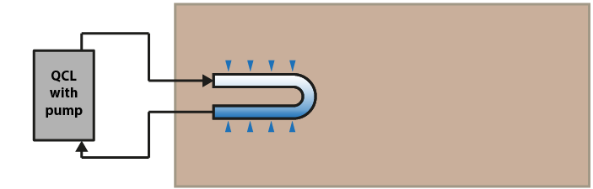
Automated sampling of soil air with direct isotopic analysis
151 soil gas probes/slope
  Microporous PTFE tubing (30cm exchange loop)
  sealed at both ends to gas transport lines
Closed loop sampling → full equilibration

Slide 7
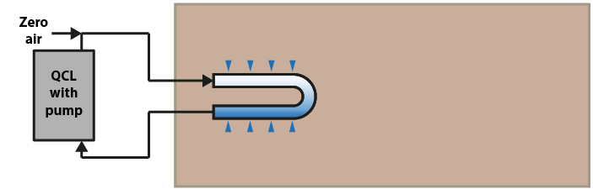
Automated sampling of soil air with direct isotopic analysis
151 soil gas probes/slope
  Microporous PTFE tubing (30cm exchange loop)
  sealed at both ends to gas transport lines
Closed loop sampling → full equilibration
Dilution → condensation prevention

Slide 8
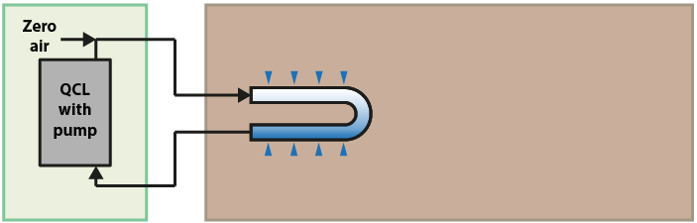
Automated sampling of soil air with direct isotopic analysis
151 soil gas probes/slope
  Microporous PTFE tubing (30cm exchange loop)
  sealed at both ends to gas transport lines
Closed loop sampling → full equilibration
Dilution → condensation prevention
Shed with AC → temperature stability

Slide 9
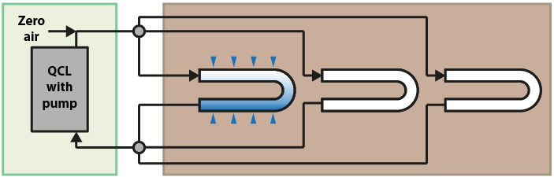
Automated sampling of soil air with direct isotopic analysis
151 soil gas probes/slope
  Microporous PTFE tubing (30cm exchange loop)
  sealed at both ends to gas transport lines
Closed loop sampling → full equilibration
Dilution → condensation prevention
Shed with AC → temperature stability
Multi-valve system → automated sampling

Slide 10
Automated sampling of soil air with direct isotopic analysis
Ca. 4 min/sample
No manual sample collection or lab analysis
Small sample volumes
Simultaneous isotope data for CO₂ and water vapor in soil air + Inference of liquid water isotopic composition

Slide 11
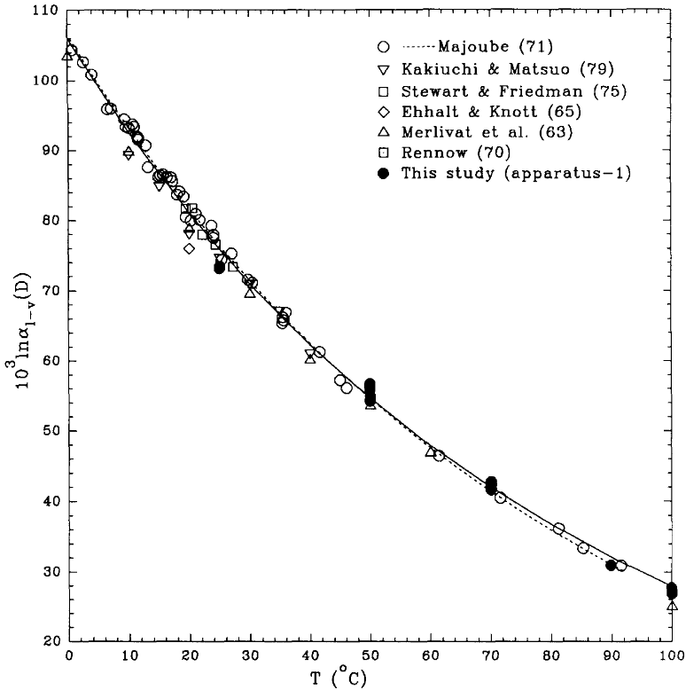
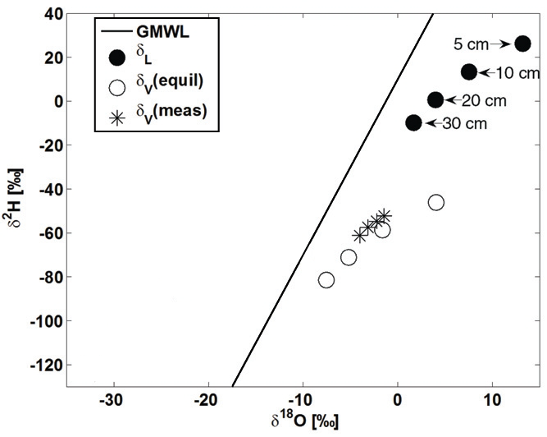
Inference of liquid soil water isotopic composition from vapor
Vapor typically in isotopic equilibrium with liquid water
→ Liquid water composition can be infered if temperature-dependent equilibrium fractionation factor is known
Free water
Soil
Horita & Wesolowski, Geochim. Cosmochim. Acta 58, 3425-3437 (1994).
Soderberg et al., Vadose Zone J. 11 (2012).

Slide 12
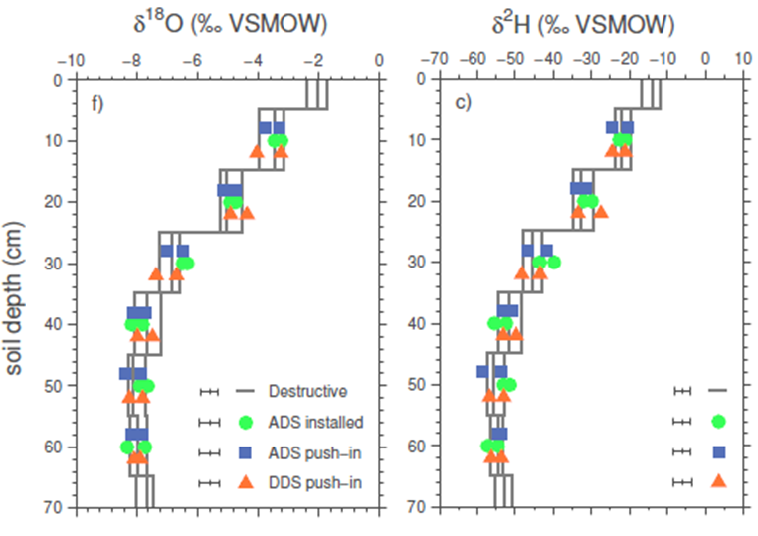
Inference of liquid soil water isotopic composition from vapor
Potential effects on α_{E} in soils: water activity (salts, matric potential), structural change in confined space, hydration sphere isotope effect → minor at MP > -10 MPa and low clay content
Potential sampling induced mixing → can be avoided
Soderberg et al., Vadose Zone J. 11 (2012).
Volkmann & Weiler, HESS 18, 1819-1833 (2014).

Slide 13
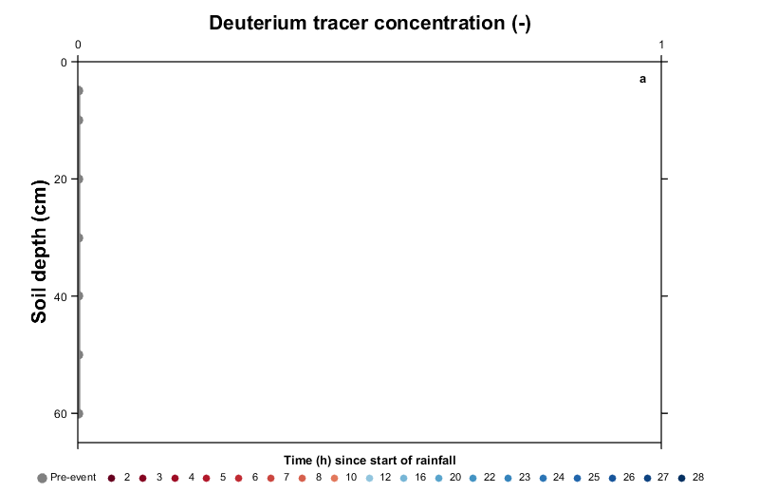
Inference of liquid soil water isotopic composition from vapor

Slide 14
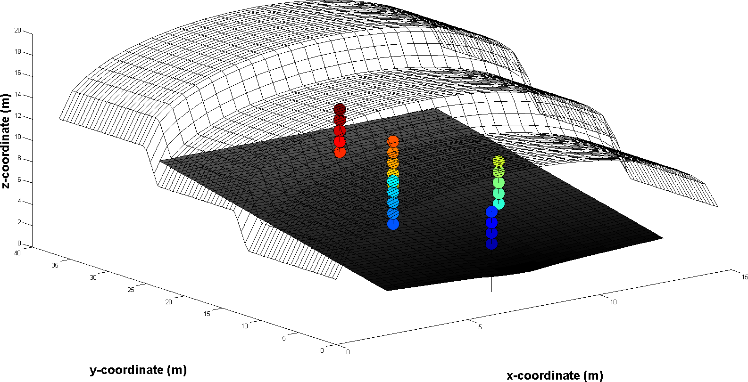
Atmospheric sampling
Exisiting gas sampling set up for 24 locations/slope
Flow cell 1/e time response (s): 0.1 sec (300 lpm)
→Evapotranspiration, CO₂ fluxes and plant uptake

Slide 15
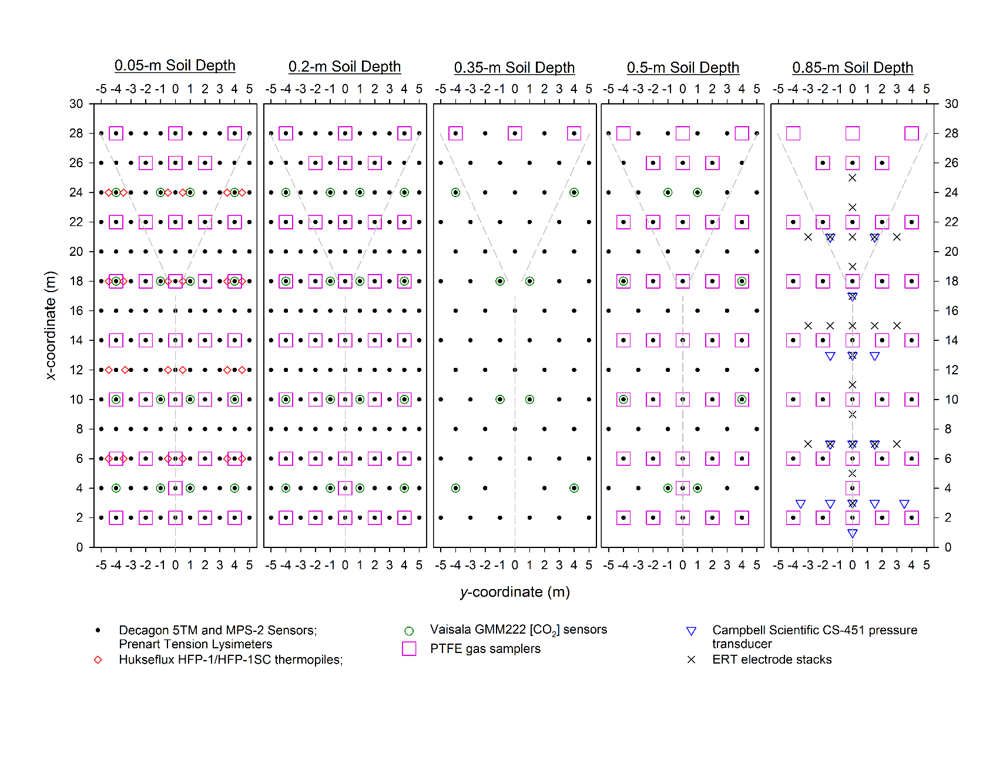
Potential soil gas sampling locations

Slide 16
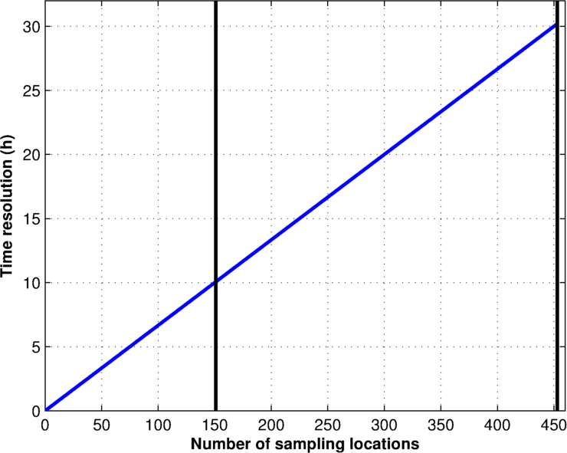
Location-Time resolution trade-off for soil gas sampling
Which processes to investigate?
What is their temporal scale?
All locations
1 slope
All locations
3 slopes

Slide 17
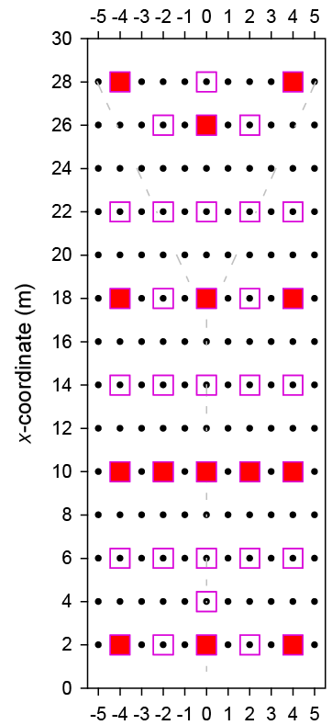
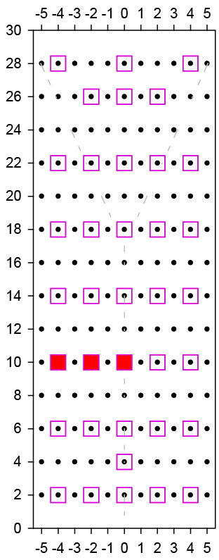

Potential scheme for soil gas sampling
50-150 locations per slope b/w events → 10-30 h time step
10-15 locations on 1 slope during rainfall → 1 h time step

Slide 19
