Slide 1
Comparison of hydrologic and geochemistry response from
LEO-C/W (2015) and LEO-E (2013)
B2 Science Meeting 05/08/2015

Slide 2
Soil water content response (Till Volkmann & Luke Pangle)
Geochemistry response (Katerina Dontsova)
Soil air CO₂ dynamics (Joost van Haaren)

Slide 3
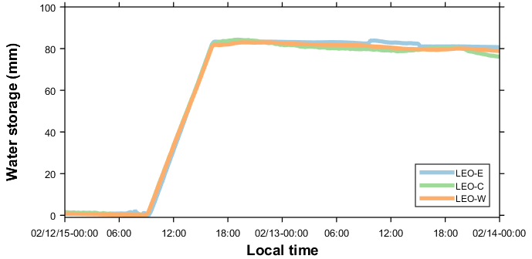
Comparable event
LEO-E : 25 Jan 2013
LEO-C/W : 12 Feb 2015
81 mm (12 mm/h for ca. 7 h)
Similar antecedent wetness (ca. 8 %-vol)

Slide 4
Soil water content response
Till Volkmann & Luke Pangle

Slide 5
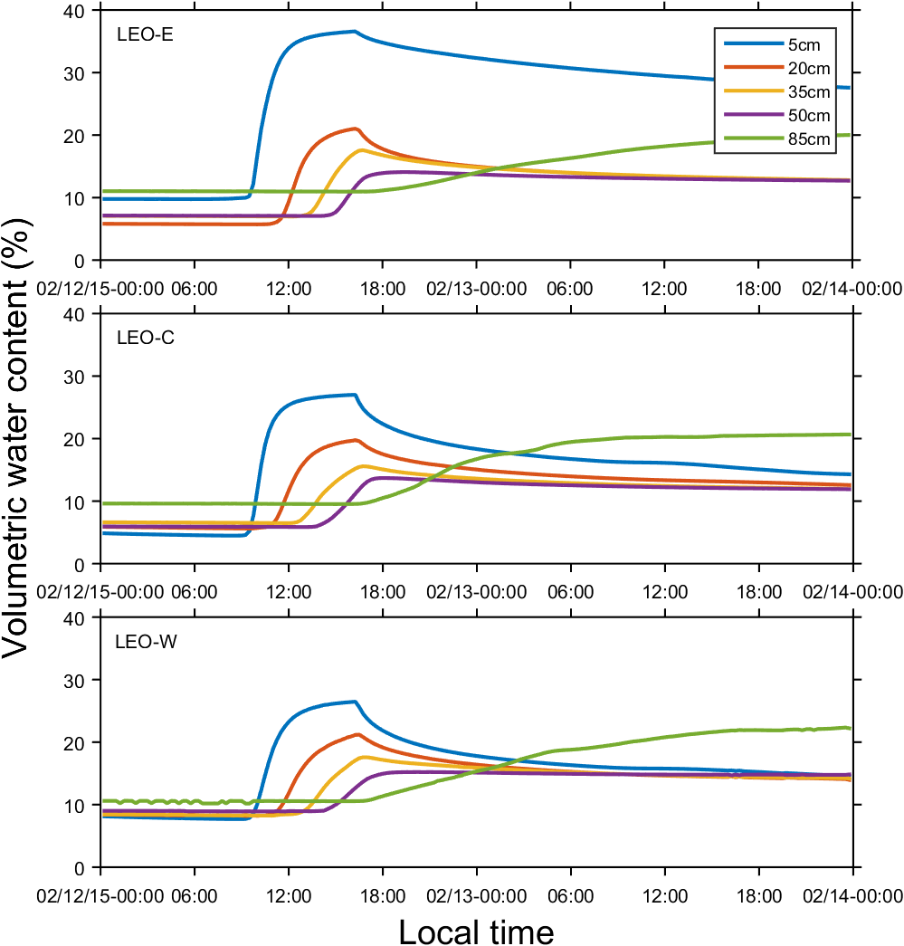
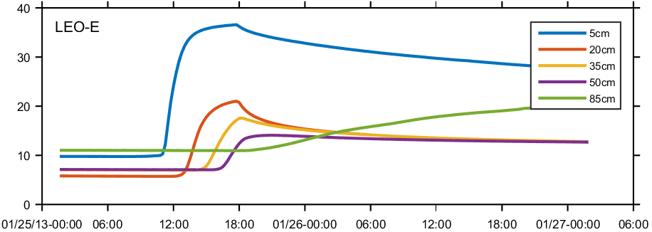
Soil water content response

Slide 6
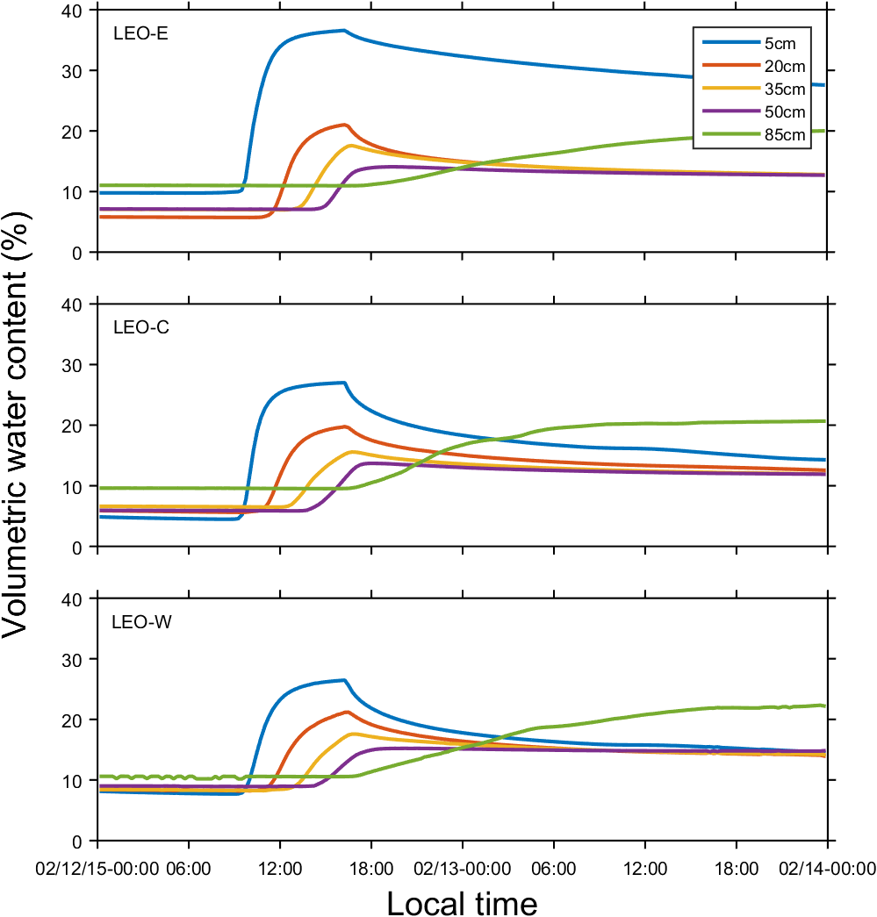
Soil water content response
Difference 5cm:
ca. 10%-vol
Difference rest:
<2%-vol

Slide 7
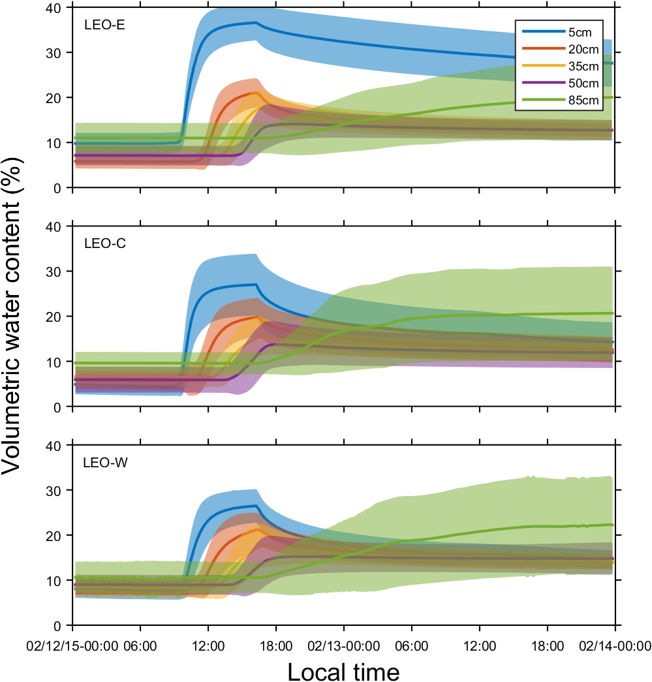
Soil water content response
Difference not
due to outliers

Slide 8
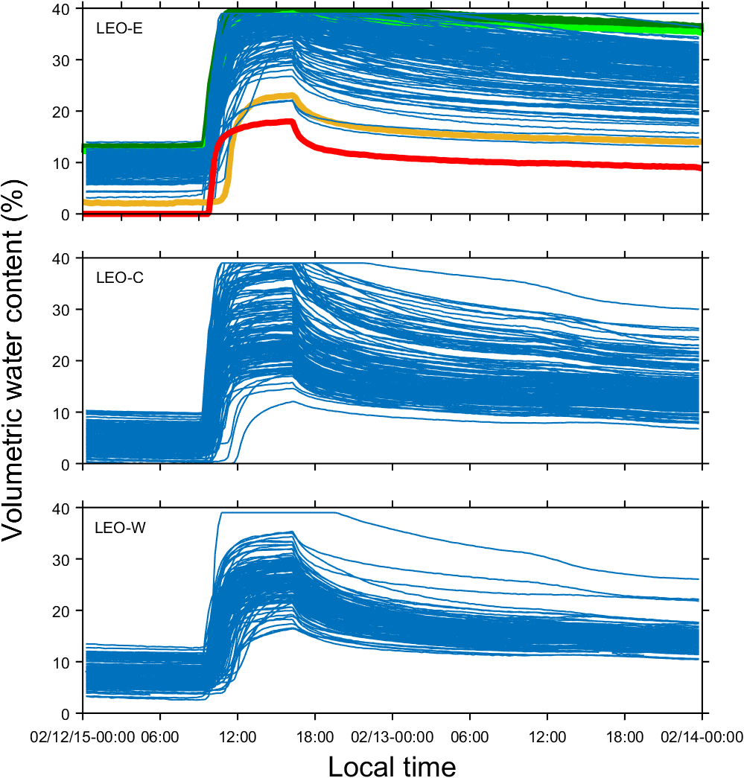
Soil water content response
Perhaps due to
probe bias?

Slide 9
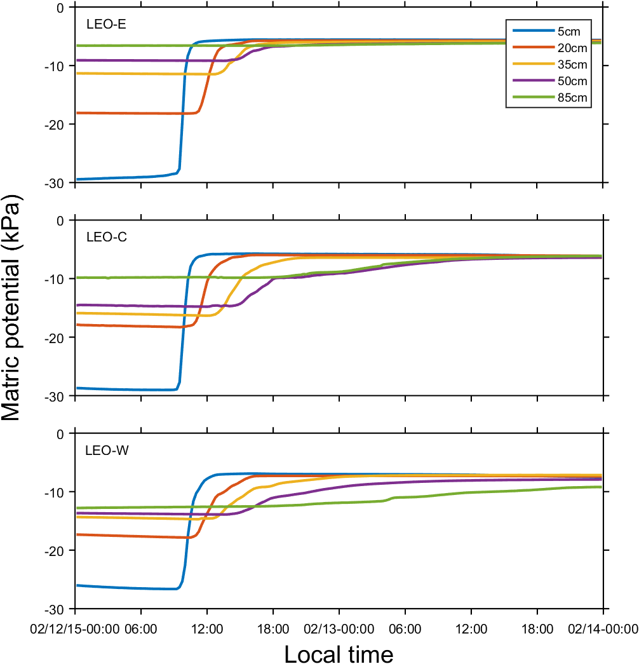
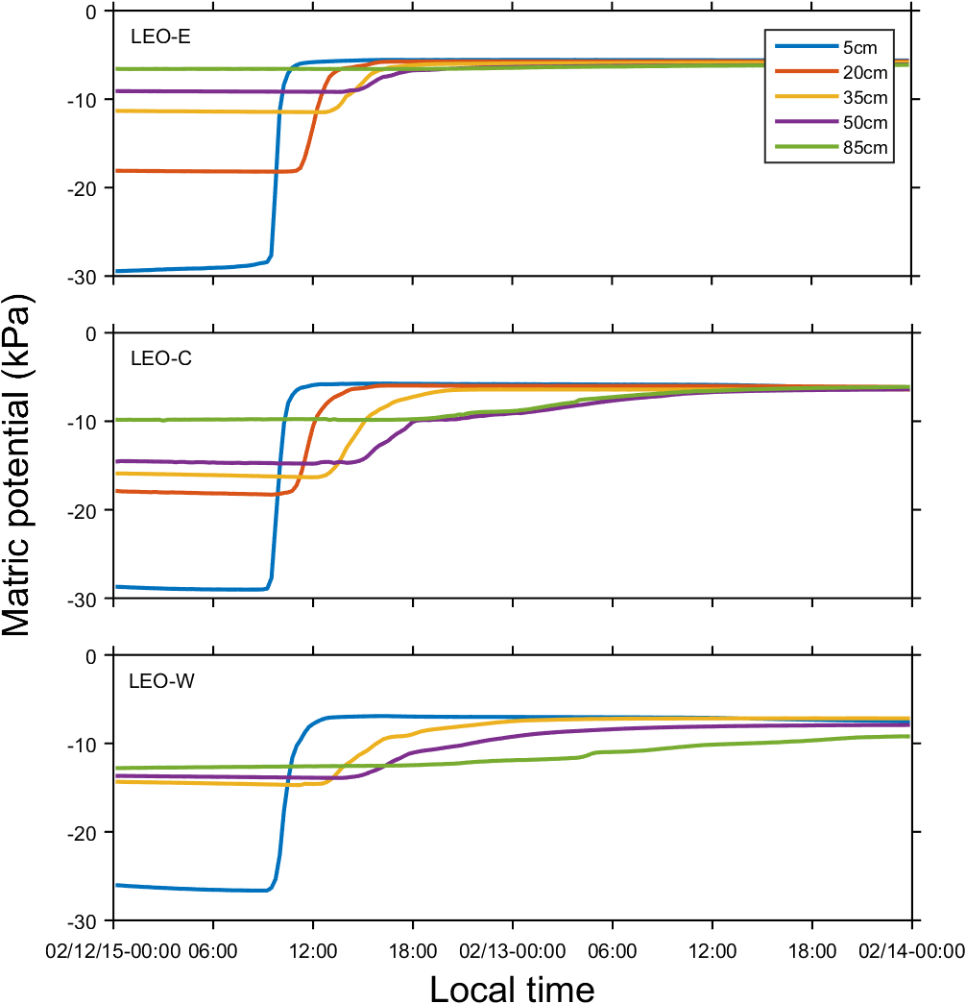
Soil water content response
Matric potential
similar at 5cm

Slide 10
Geochemistry response
Katerina Dontsova

Slide 13
Soil air CO₂ dynamics
Joost van Haren

Slide 14
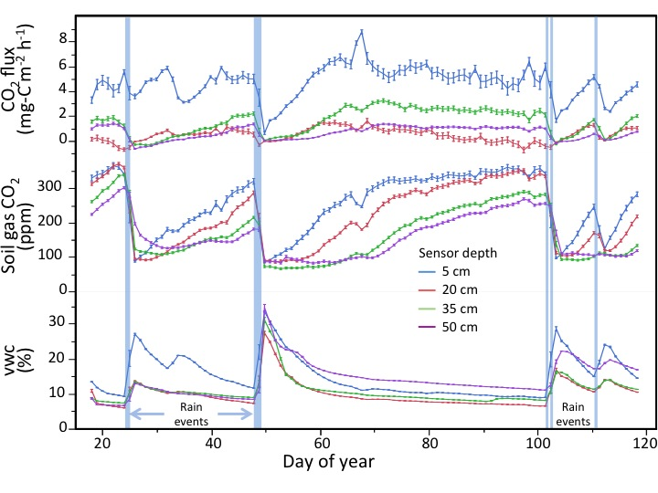
CO₂ soil gas measurements and fluxes
Precipitation events cause:
Increase in soil moisture content
Decrease in soil CO₂ concentrations
Decrease CO₂ gas flux, due to waterlogged pores
Diffusion limitation due to water filled pore spaces immediately following the rains
Slower recovery of soil CO₂ concentrations at depth further indicates diffusion limitation to weathering

Slide 15
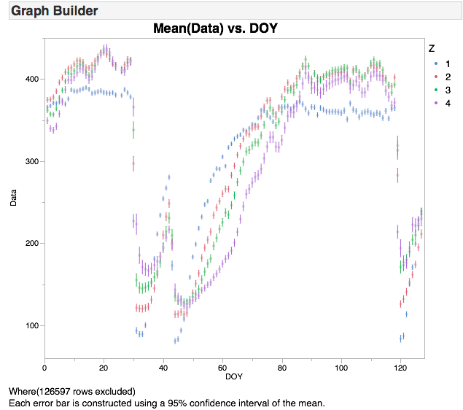
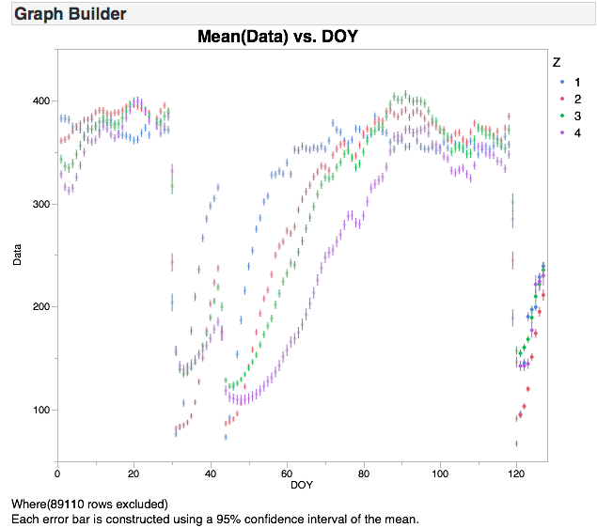
West Center
Very raw data!
400
300
CO₂ (ppm)
200
100
0
40
80
120
0
40
80
120
DOY
DOY
West and Center bay soil CO₂ concentrations over time, since Jan 01, 2015 to May 04, 2015.
Data processed to filter out the bad sensors, not processed yet for pressure and temperature.
Overall, behavior of the sensors in both bays are qualitatively identical.

Slide 16
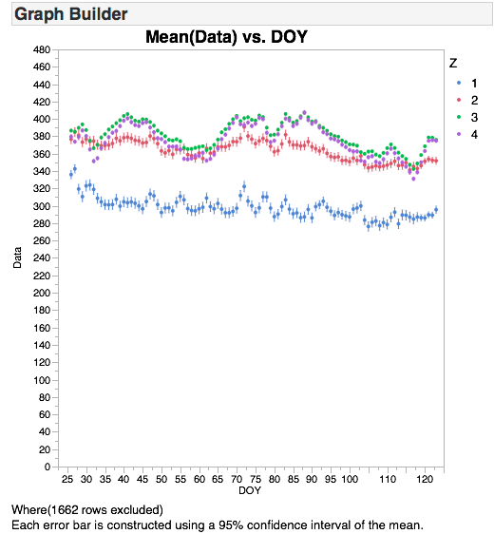
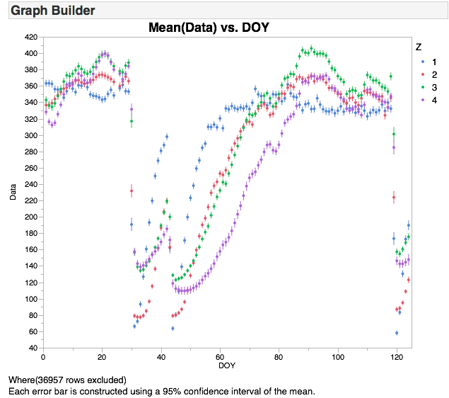
East Center
Very raw data!
East and Center bay soil CO₂ concentrations over time, since Jan 01, 2015 to May 04, 2015.
Data processed to filter out the bad sensors, not processed yet for pressure and temperature.
Overall, behavior of the sensors in East bay is not affected by added water.

Slide 17
Additional slides

Slide 18
