Slide 1
Agenda:
3:00 pm: Welcome Till Volkmann
3:05 – 3:25 pm: Summary of planned irrigation events on LEO-C and LEO-W during January and February (Luke)
3:25 – 3:40 pm: What temporal frequency do we need for aboveground gas measurements? Current state of the system and possible improvements (Till)
3:40 – 4:00 pm: Do we want to improve our ability to manipulate air circulation above the landscapes? If so, how?

Slide 2
January 25th, 2013
81 mm of irrigation was applied to LEO-E. The rate was 12 mm h⁻¹ for 6.75 h.

Slide 3
Manual sampling during the January irrigation event on LEO-C and LEO-W
81 mm event in January
  Prenarts: single samples from 70 locations in each slope, consistent with sampling scheme in 2013.
  Seepage: sample cumulative outflow hourly
  Irrigation water: sample in tanks to quantify pH and DIC
  Destructive soil sampling: extract cores from both landscapes at the same location as from LEO-E

Slide 4
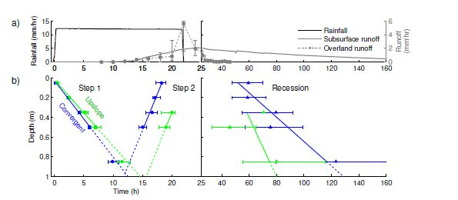
February 18th – 19th, 2013 on LEO-E
264 mm of irrigation was applied to LEO-E. The rate was 12 mm h⁻¹ for 22 h.
February 2015 on LEO-C and LEO-W
144 mm of irrigation to be applied at a rate of 12 mm h⁻¹ over 12 h.

Slide 5
Scenarios for applying the remaining 120 mm
Scenario 1:
  12 mm/h applied over 10 h, following a drying period
    Exact same intensity and duration of irrigation as on LEO-E
    Necessary to have a drying period before application
Scenario 2:
  No drying period; stepping down intensity over a longer time
    No drying period; continuously maintain zone of saturation
    Should be guided by preliminary modeling, and include continuous monitoring of water table height
    Different intensity and duration as occurred over LEO-E
Scenario 3:
  6 mm/h applied over 20 h, with a drying period
    Examine steady-state infiltration under different irrigation intensities
    Requires drying period, and includes different intensity and duration than occurred over LEO-E

Slide 6
Figure 1: Soil water sampler locations included in the sampling are shown.
Those sampled at four depths are shown in blue, those at three depths in red.
Locations not included in the sampling scheme are shown in grey.

